Slide 1


-- Least Squares Fitting – Finite-Dimensional Vector Spaces
Xavier Granier

Slide 2
General considerations on objectives

Slide 3
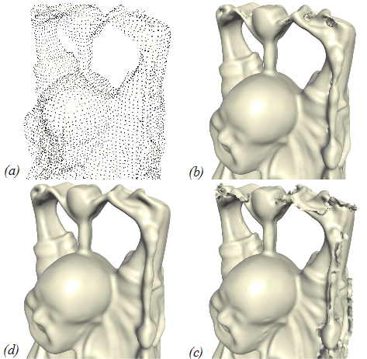
Data approximation and analysis
Data from real measurements
How to use them in simulation / rendering ?
Ex: acquired point clouds for geometry
[Chen et al. – CGF 2013]
FP8: Surfaces II
Auditorium Schweitzer - Wednesday - 10:40 - 12:20

Slide 4
Data approximation and analysis
Data from real measurements
How to use them in simulation / rendering ?
How to study the general behavior ?
Ex: data extrapolation in statistics

Slide 5
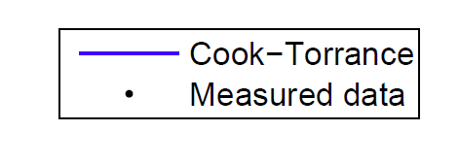
Data approximation and analysis
Data from real measurements
How to use them in simulation / rendering ?
How to study the general behavior ?
How to remove the noise ?
Ex: BRDF measures at grazing angle
Material – Dark blue paint
[Ngan et al. – EGSR 2005]

Slide 6
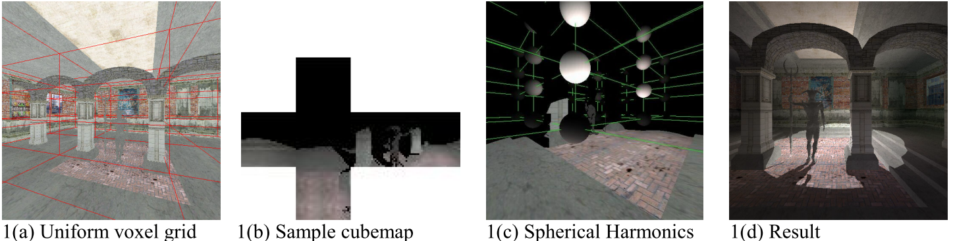
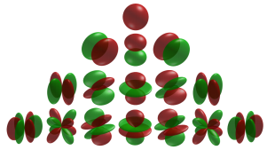
Data modeling and conversion
Computed data
Conversion between representations
Ex: environment map to spherical harmonics
[Nijasure et al. – JGT 2005]

Slide 7

Data modeling and conversion
Computed data
Conversion between representations
Objective-based modeling
Ex: anisotropic BRDF orientation field
[Raymond et al. – EG 2014]
FP10: Rendering
Room ARP – Thursday - 8:30 - 10:10

Slide 8
Generalized Goal
Finding the best approximation
Given a numerical model
Using a reduce set of parameters
Ex: linear regression
y = ax + b
( x₃ , y₃ )
( x₆ , y₆ )
( x₅ , y₅ )
( x₁ , y₁ )
( x₇ , y₇ )
( x₄ , y₄ )
( x₂ , y₂ )

Slide 9
Definition of “Best”
Maximize the quality
Ex: expectation maximization
Be as close as possible to the goal
Need a notion of distance / norm
To be minimized

Slide 10
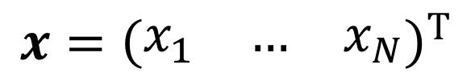
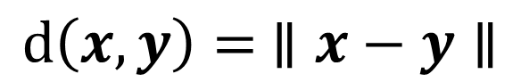
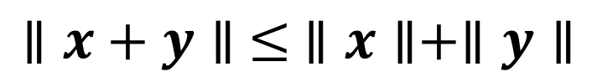
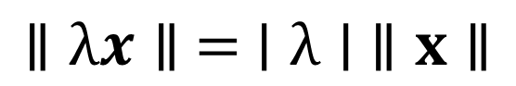
Definitions
$$x={\left(\begin{matrix}x_{1} & … & x_{N}\end{matrix}\right)}^{T}$$
Norm
Separate points
Absolute homogeneity
Triangle inequality
Distance
$$∥x∥ =0⇔∀i=1..N,x_{i}=0$$
$$∥λx∥ = ∣λ∣ ∥x∥$$
$$∥x+y∥ ≤ ∥x∥+∥y∥$$
$$d\left(x,y\right)= ∥x−y∥$$

Slide 11
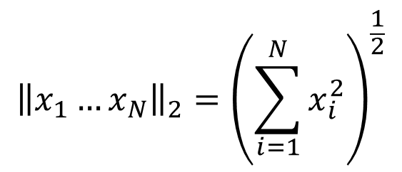
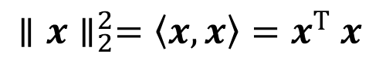
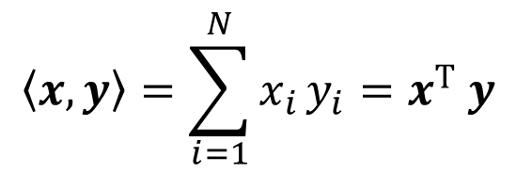
Euclidian Norm for Least Squares
Based on standard dot product
Error ≈ average distance
Uniform weight for each dimension
$$〈x,y〉=\sum_{i=1}^{N}{x_{i}}y_{i}=x^{T} y$$
$${\left\|x_{1}…x_{N}\right\|}_{2}={\left(\sum_{i=1}^{N}{x_{i}^{2}}\right)}^{\frac{1}{2}}$$
$$∥x∥_{2}^{2}=〈x,x〉=x^{T} x$$

Slide 12
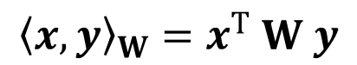
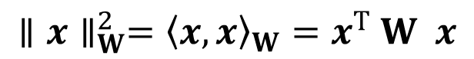
Euclidian Norm for Least Squares
Generalized dot product
W: symmetric positive definite matrix
Error ≈ weighted average distance
W is a diagonal matrix
$${〈x,y〉}_{W}=x^{T} W y$$
$$∥x∥_{W}^{2}={〈x,x〉}_{W}=x^{T} W x$$

Slide 13
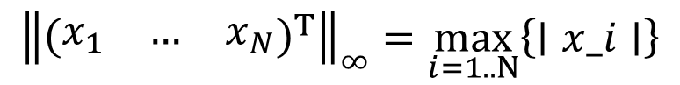
Other: max norm
Maximum of absolute values
Largest error
$${\left\|{\left(\begin{matrix}x_{1} & … & x_{N}\end{matrix}\right)}^{T}\right\|}_{∞}=\max_{i=1..N}\left\{∣x_i∣\right\}$$

Slide 14
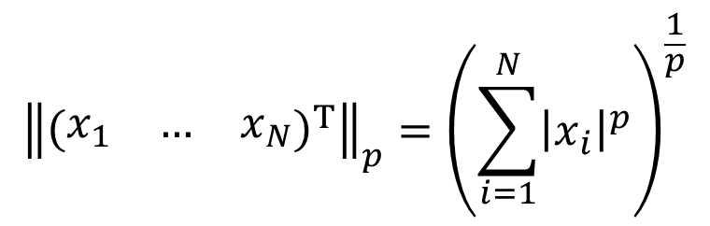
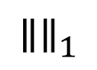
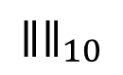
Other: p-norm
$${\left\|{\left(\begin{matrix}x_{1} & … & x_{N}\end{matrix}\right)}^{T}\right\|}_{p}={\left(\sum_{i=1}^{N}{{\left|x_{i}\right|}^{p}}\right)}^{\frac{1}{p}}$$
$$∥∥_{10}$$
$$∥∥_{1}$$
Generalizing the Euclidian norm

Slide 15
Linear Optimization
Least Squares

Slide 16
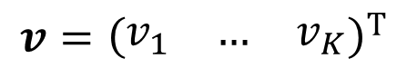
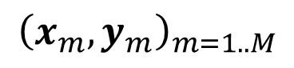
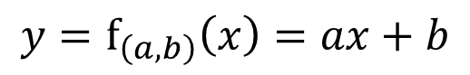
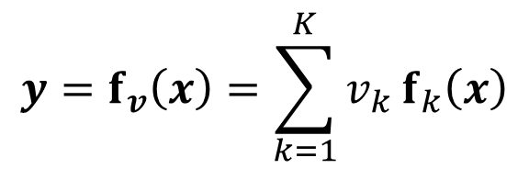
Linear optimization
$${\left(x_{m},y_{m}\right)}_{m=1..M}$$
M measured data
Linear approximating function
Parameters: v
Linear combination of basis function: f_{k}
2D example: 2D line y = ax + b
$$v={\left(\begin{matrix}v_{1} & … & v_{K}\end{matrix}\right)}^{T}$$
$$y=f_{v}\left(x\right)=\sum_{k=1}^{K}{v_{k}}f_{k}\left(x\right)$$
$$y=f_{\left(a,b\right)}\left(x\right)=ax+b$$

Slide 17
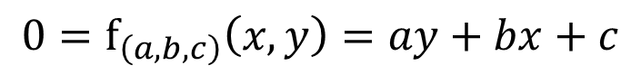
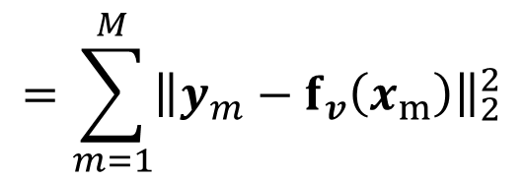
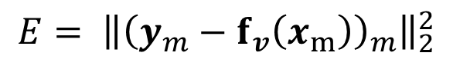
Least Squares
Minimize Euclidian error = objective
Unique solution if well conditioned
Do not contain the trivial solution v = 0
Example: implicit line
Measures ≥ parameters: M ≥ K
Measures are different
$$=\sum_{m=1}^{M}{{\left\|y_{m}−f_{v}\left(x_{m}\right)\right\|}_{2}^{2}}$$
$$E= {\left\|{\left(y_{m}−f_{v}\left(x_{m}\right)\right)}_{m}\right\|}_{2}^{2}$$
$$0=f_{\left(a,b,c\right)}\left(x,y\right)=ay+bx+c$$

Slide 18
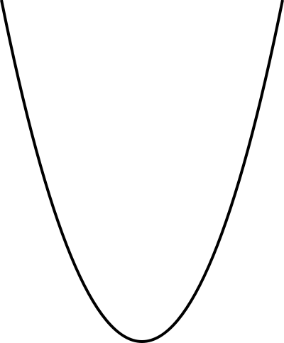
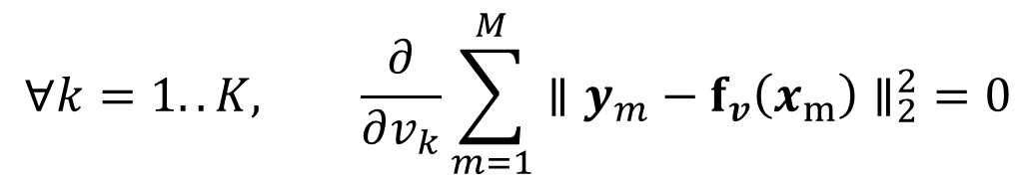
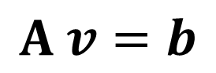
Solving Linear Least Squares
Properties of the objective function
Positive
Quadratic
Parabola
Minimum when gradient = 0
Lead to a linear system to solve
$$∀k=1..K, \frac{∂}{∂v_{k}}\sum_{m=1}^{M}{∥y_{m}−f_{v}\left(x_{m}\right)∥_{2}^{2}}=0$$
$$A v=b$$

Slide 19
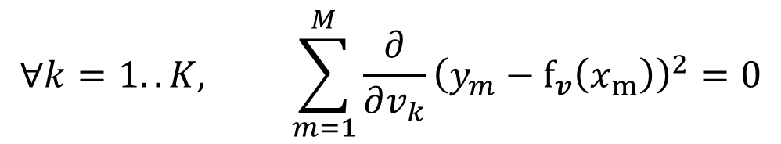
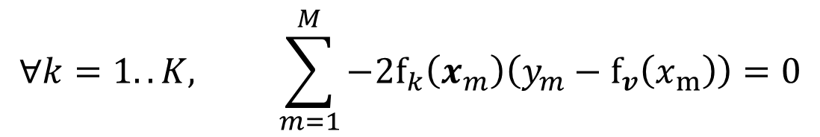
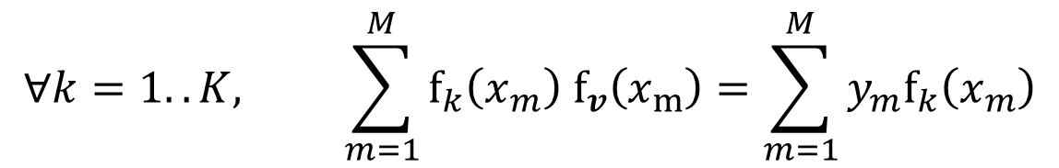
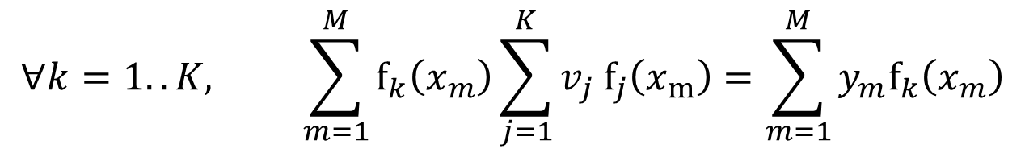
Demonstration 1D
$$∀k=1..K, \sum_{m=1}^{M}{\frac{∂}{∂v_{k}}{\left(y_{m}−f_{v}\left(x_{m}\right)\right)}_{}^{2}}=0$$
$$∀k=1..K, \sum_{m=1}^{M}{−2f_{k}\left(x_{m}\right)\left(y_{m}−f_{v}\left(x_{m}\right)\right)}=0$$
$$∀k=1..K, \sum_{m=1}^{M}{f_{k}\left(x_{m}\right) f_{v}\left(x_{m}\right)}=\sum_{m=1}^{M}{y_{m}f_{k}\left(x_{m}\right)}$$
$$∀k=1..K, \sum_{m=1}^{M}{f_{k}\left(x_{m}\right)\sum_{j=1}^{K}{v_{j} f_{j}\left(x_{m}\right)}}=\sum_{m=1}^{M}{y_{m}f_{k}\left(x_{m}\right)}$$

Slide 20
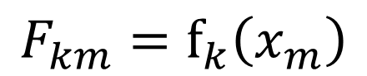
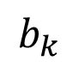
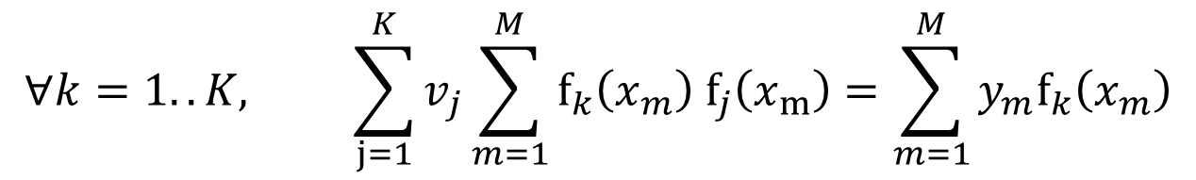

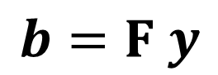
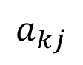
Corresponding Linear System
$$∀k=1..K, \sum_{j=1}^{K}{v_{j}\sum_{m=1}^{M}{f_{k}\left(x_{m}\right) f_{j}\left(x_{m}\right)}}=\sum_{m=1}^{M}{y_{m}f_{k}\left(x_{m}\right)}$$
$$a_{kj}$$
$$b_{k}$$
$$A =F F^{T}$$
$$b=F y$$
$$F_{km}=f_{k}\left(x_{m}\right)$$
A symmetric (positive-definite)

Slide 21
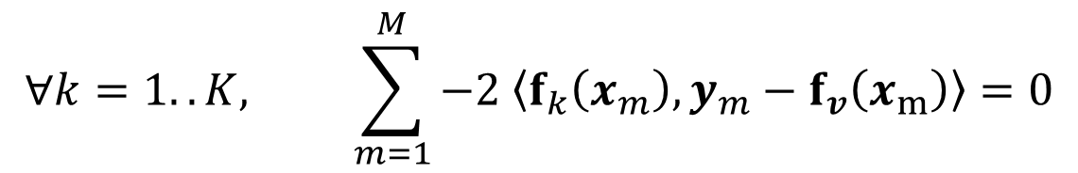
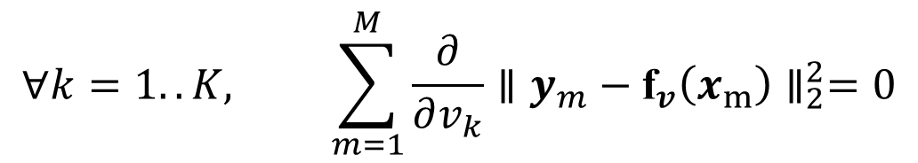
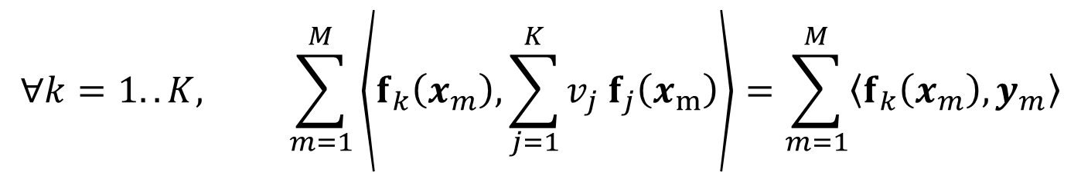
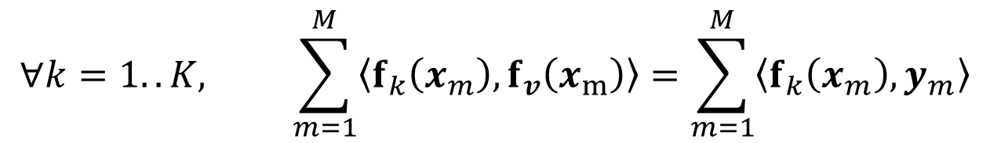
Demonstration ND
$$∀k=1..K, \sum_{m=1}^{M}{\frac{∂}{∂v_{k}}}∥y_{m}−{\text{f}}_{v}\left(x_{m}\right)∥_{2}^{2}=0$$
$$∀k=1..K, \sum_{m=1}^{M}{−2 \left\langle f_{k}\left(x_{m}\right),y_{m}−f_{v}\left(x_{m}\right)\right\rangle }=0$$
$$∀k=1..K, \sum_{m=1}^{M}{\left\langle f_{k}\left(x_{m}\right), f_{v}\left(x_{m}\right)\right\rangle }=\sum_{m=1}^{M}{\left\langle f_{k}\left(x_{m}\right),y_{m}\right\rangle }$$
$$∀k=1..K, \sum_{m=1}^{M}{\left\langle f_{k}\left(x_{m}\right),\sum_{j=1}^{K}{v_{j} f_{j}\left(x_{m}\right)}\right\rangle }=\sum_{m=1}^{M}{\left\langle f_{k}\left(x_{m}\right),y_{m}\right\rangle }$$

Slide 22
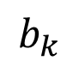
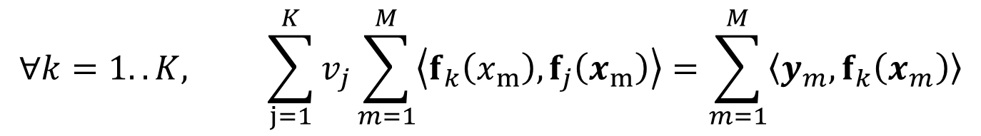
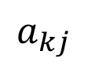
Corresponding Linear System
$$∀k=1..K, \sum_{j=1}^{K}{v_{j}\sum_{m=1}^{M}{\left\langle f_{k}\left(x_{m}\right),f_{j}\left(x_{m}\right)\right\rangle }}=\sum_{m=1}^{M}{\left\langle y_{m},f_{k}\left(x_{m}\right)\right\rangle }$$
$$a_{kj}$$
$$b_{k}$$
A symmetric (positive-definite)

Slide 23
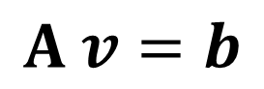
Equivalent Linear System
Minimal least squares error
Equivalent linear system
A symmetric
If well conditioned, A positive-definite
How to solve it ?
Use your favorite linear algebra solver
Ex: Cholesky factorization
$$A v=b$$

Slide 24
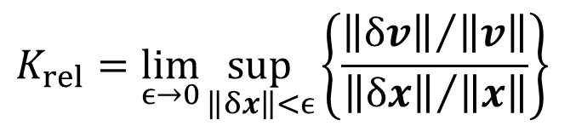
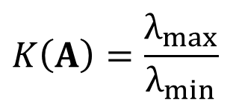
Conditioning of a linear system
$$K_{rel}=\lim_{ϵ→0}{\sup_{\left\|δx\right\|<ϵ}\left\{\frac{{\left\|δv\right\|}/{\left\|v\right\|}}{{\left\|δx\right\|}/{\left\|x\right\|}}\right\}}$$
$$Κ\left(A\right)=\frac{λ_{max}}{λ_{min}}$$
Conditioning = stability of a system
Input: x (perturbation x + δx)
Output: v (perturbation v + δv)
Relative conditioning
Smaller is better
For a linear system
Conditioning of the matrix
Symmetric positive-definite matrix
Ratio of eigenvalues

Slide 25
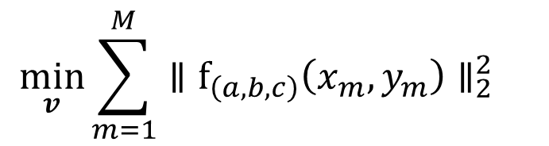
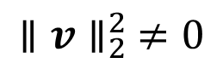
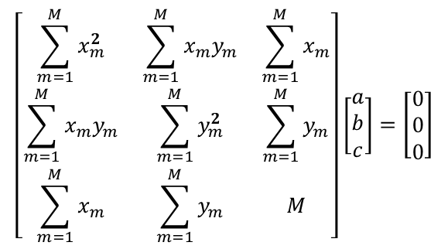
Adding constraints
For regularization
Improvement on conditioning
Removing trivial solution
Example of implicit line
$$∥v∥_{2}^{2} ≠0$$
$$\min_{v}{\sum_{m=1}^{M}{∥f_{\left(a,b,c\right)}\left(x_{m},y_{m}\right)∥_{2}^{2} } }$$
$$\left[\begin{matrix}\sum_{m=1}^{M}{x_{m}^{2}} & \sum_{m=1}^{M}{x_{m}y_{m}} & \sum_{m=1}^{M}{x_{m}} \\ \sum_{m=1}^{M}{x_{m}y_{m}} & \sum_{m=1}^{M}{y_{m}^{2}} & \sum_{m=1}^{M}{y_{m}} \\ \sum_{m=1}^{M}{x_{m}} & \sum_{m=1}^{M}{y_{m}} & M\end{matrix}\right]\left[\begin{matrix}a \\ b \\ c\end{matrix}\right]=\left[\begin{matrix}0 \\ 0 \\ 0\end{matrix}\right]$$

Slide 26
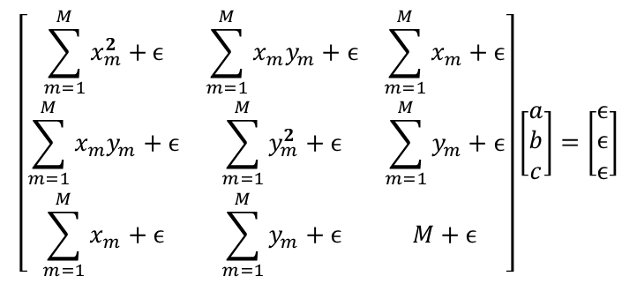

Adding constraints
For regularization
Improvement on conditioning
Removing trivial solution
Example of implicit line
$$∥v∥_{2}^{2} ≠0$$
$$\min_{v}{\sum_{m=1}^{M}{∥f_{\left(a,b,c\right)}\left(x_{m},y_{m}\right)∥_{2}^{2} }+ϵ{\left(a+b+c−1\right)}^{2} }$$
$$\left[\begin{matrix}\sum_{m=1}^{M}{x_{m}^{2}+}ϵ & \sum_{m=1}^{M}{x_{m}y_{m}+ϵ} & \sum_{m=1}^{M}{x_{m}+ϵ} \\ \sum_{m=1}^{M}{x_{m}y_{m}}+ϵ & \sum_{m=1}^{M}{y_{m}^{2}+ϵ} & \sum_{m=1}^{M}{y_{m}}+ϵ \\ \sum_{m=1}^{M}{x_{m}}+ϵ & \sum_{m=1}^{M}{y_{m}+ϵ} & M+ϵ\end{matrix}\right]\left[\begin{matrix}a \\ b \\ c\end{matrix}\right]=\left[\begin{matrix}ϵ \\ ϵ \\ ϵ\end{matrix}\right]$$

Slide 27
Adding constraints
For regularization
Improvement on conditioning
Removing trivial solution
Example of implicit line
Other linear constraints
Ex: continuity, … (cf. geometry part)
$$∥v∥_{2}^{2} ≠0$$
$$\min_{v}{\sum_{m=1}^{M}{∥f_{\left(a,b,c\right)}\left(x_{m},y_{m}\right)∥_{2}^{2} }+ϵ{\left(a+b+c−1\right)}^{2} }$$

Slide 28





Lagrange Multipliers
Approach
Original objective
A new constraint
New objective
Minimum is reached when
$$\min_{v} E\left(v\right)$$
$$g\left(v\right)=c$$
$$\min_{v,λ} E\left(v\right)+λ\left(g\left(v\right)−c\right)$$
$$\frac{∂}{∂v_{k}}E\left(v\right)+λ\frac{∂}{∂v_{k}}g\left(v\right)=0$$
$$\frac{∂}{∂λ}\left(E\left(v\right)+λ\left(g\left(v\right)−c\right)\right)=0=g\left(v\right)−c$$

Slide 29


Equivalent Linear System
$$g_{j}^{T} v=c_{j}$$
$$\min_{v}{\sum_{m=1}^{M}{∥y_{m}−f_{v}\left(x_{m}\right)∥_{2}^{2}}}+\sum_{j=1}^{J}{λ_{j}}\left(g_{j}^{T} v−c_{j}\right)$$
If multiple linear constraints
New objective function
Unique solution if it exists
But matrix may not be symmetric
Cf. geometry part of the tutorial

Slide 30
Linear Least Squares - Summary
Avantages
Euclidian norm : in average the best
Robust to noise
Linear system to solve : unique solution
Extensions
Non-uniform norm
Linear constraints as equalities
But
Minimizing maximal error ?
Inequality linear constraints ?

Slide 31
Linear Optimization
Linear/Quadratic Programming

Slide 32
Inequality constraints
For regularization
Improvement on conditioning
Removing trivial solution
Example of implicit line
Other linear constraints
Ex: continuity, … (cf. geometry part)
Definition domain (see BRDF fitting)
$$∥v∥_{2}^{2} ≠0$$
$$\min_{v}{\sum_{m=1}^{M}{∥f_{\left(a,b,c\right)}\left(x_{m},y_{m}\right)∥_{2}^{2} }+ϵ{\left(a+b+c−1\right)}^{2} }$$

Slide 33



Linear Programing
Minimizing the max-norm
Toward linear programing
$${\text{min}}_{v}{ \text{max}}_{m=1}^{M}{\left.∥y_{m}−{\text{f}}_{v}\left(x_{m}\right)∥\right.}_{∞}$$
$${⇔\text{min}}_{v}{\left.∥y−{\text{f}}_{v}\left(x\right)∥\right.}_{∞}$$
$$⇔\begin{matrix}{\text{min}}_{v,ϵ}ϵ \\ \text{subject} \text{to}\left\{\begin{matrix}ϵ≥0 & \\ −y_{m}+{\text{f}}_{v}\left(x_{m}\right)+ϵ≥0 & ∀m \\ y_{m}−{\text{f}}_{v}\left(x_{m}\right)−ϵ≥0 & ∀m\end{matrix}\right.\end{matrix}$$

Slide 34

Linear programing
Objective: dot product
Constraints: linear equalities and inequalities
Unique solution if it exists
Solver
Simplex algorithm
#iterations ~ O(#constraints)
$$\begin{matrix}\min_{v}{{ a}^{\text{T}}v} \\ \begin{aligned}subject to { b}_{m}^{\text{T}}v≤c_{m} \\ { d}_{m}^{\text{T}}v=e_{m}\end{aligned}\end{matrix}$$

Slide 35

Simplex: Standard Form
$$\begin{matrix}\begin{aligned}\max_{v}{a^{T}}v \\ \end{aligned} \\ subject to \left\{\begin{matrix}b_{m}^{T} v+c_{m}=d_{m} & ∀m \\ v_{k}≥0 & ∀k \\ c_{m}≥0 & ∀m\end{matrix}\right. \\ \begin{aligned} \\ with \left\{\begin{matrix}v={\left(\begin{matrix}v_{1} & .. & v_{k}\end{matrix}\right)}^{T} \\ a={\left(\begin{matrix}a_{1} & .. & a_{k}\end{matrix}\right)}^{T} \\ b_{m}={\left(\begin{matrix}b_{m1} & .. & b_{mk}\end{matrix}\right)}^{T} \end{matrix}\right.\end{aligned}\end{matrix}$$

Slide 36
Geometrical Analogy
Maximize 3 x₁ + 5 x₂
Constraints
x₁ ≤ 4
x₂ ≤ 6
3 x₁ + 2 x₂ ≤ 18
x₁ ≥ 0
x₂ ≥ 0

Slide 37
Geometrical Analogy
x₂
36 = 3 x₁ + 5 x₂
x₁ = 4
8
6
x₂ = 6
20 = 3 x₁ + 5 x₂
4
10 = 3 x₁ + 5 x₂
2
3 x₁ + 2 x₂ = 18
0
x₁
2
4
6
8
10

Slide 38

Quadratic Programing
Term to minimize = quadratic form
Iterative solver
Classical least squares solver
Langrage multiplier for equalities
If some inequalities are not fulfilled
Take one and transform it into an equality
Unique solution if it exists
$$\begin{matrix}\min_{v}{v^{T}Q^{T}v}+d^{T}v \\ subject to \left\{\begin{matrix}c_{j}^{T} v=b_{j} \\ c_{m}^{T} v≤b_{m}\end{matrix}\right.\end{matrix}$$

Slide 39



Ex: Fitting with Rational Functions
Application to BRDF
MERL MIT database
$$ρ(ω_{i},ω_{o})≈r_{N,M}(ω_{i},ω_{o})=\frac{\sum_{m=1}^{M}{p_{m}b_{m}(ω_{i},ω_{o})}}{\sum_{n=1}^{N}{q_{n}b_{n}(ω_{i},ω_{o})}}$$
[Pacanowski et al., TVCG 2012]

Slide 40



Rational Polynomial vs Polynomial
Faster approximation of strong variations
$e^{−x^{2}}$ with 7 parameters
Steep function with 7 parameters

Slide 41
Approximation with Rational Functions
Specialized linear methods
DCA: Simplex
Improvement by [Papamarkos 1988]
Free-pole solution
Numerical stability
New method based on vertical-segment [Celis et al. 2007]
Notes:
On peut faire du SQP on Levenberg avec des RFs mais on peut surtout faire mieux
DCA, par exemple
Voire encore mieux Vertical segment

Slide 42




Vertical Segments
$$F_{i}=\left[\underline{f_{i}},\overline{f_{i}}\right]$$
$$r_{N,M}(x)=\frac{p_{n,m} (x) }{q_{n,m} (x)}$$
$$x$$
Find the most stable rational function such as
$∀i, \underline{f_{i}}≤\frac{p_{n,m} \left(x\right)}{q_{n,m} \left(x\right)}≤\overline{f_{i}}$ and $q_{n,m} \left(x\right)>0$
$∀i, \underline{f_{i}}{ q}_{n,m} \left(x\right)≤p_{n,m} \left(x\right)≤\overline{f_{i}}{ q}_{n,m} \left(x\right)$ and $q_{n,m} \left(x\right)>0$
Equivalent to a convex quadratic optimization problem

Slide 43
Benefits of this approach
Unique solution if it exists
Pole-free
Limit case = interpolation scheme
Easy integration of additional constraints:
Symmetry
Positivity
Monotonicity (positive derivative)

Slide 44


Accurate Approximation of BRDF
Original Data
99 MB
Approximation
1,7 kB

Slide 45


ALTA Library
Open-source C++ Library
For model comparison (fitting & approximation)
Plugin mechanism
Easy to extend
Interaction with BRDF Explorer
Alpha version http://alta.gforge.inria.fr/
Open format for data (MERL, ASTM)
Non-linear approximation
Rational functions
Analytical models of BRDF
Scripting mechanism for automatic fitting
Levenberg Marquardt
CUreT
MERL
Ward
Lafortune
[Belcour et al, Inria Technical Report, 2013]
“Optimization Techniques in Computer Graphics”
Ivo Ihrke / Winter 2013
Notes:
To that aim, we propose a new open source library for BRDF analysis. *click* The goal of this library is to have a complete set of models and data gathered in the same software package to compare them and analyze them. *click* The idea is to have a cross plateform set of software and libraries implementing the existing BRDF models and data sets. We want it to be easy to extend. The goal is that adding your own BRDF model to the library of data set or fitting algorithm will takes a few lines of code. With BRDF Explorer existing, we think there is no need for another visualization tool for BRDF so we provide a BRDF explorer friendly export format

Slide 46
Non-Linear Optimization

Slide 47


Linear vs Non-linear approximation
Linear:
Global Convergence ☺
Limited expressivity ☹
Non-linear:
Local Convergence ☹
More powerful expressivity ☺
$$k_{0}+k_{1}x^{2}+k_{2}x^{3}$$
$$k_{0}+k_{1}{\left(\cos{θ}\right)}^{k_{2}}$$

Slide 48
Non-linear Optimization
When it is impossible to use
Linear combination of functions
Linear / quadratic objective function
Linear constraints
Solvers are iterative
Step by step progression toward a solution
Still where gradient is null
Convergence toward a local minima
Not a unique solution
If a unique solution exists, it will be found

Slide 49

Non-linear approximation
$$k_{0}+k_{1}{\left(\cos{θ}\right)}^{k_{2}}$$
Local convergence
Conjugate gradient methods
Levenberg-Marquardt
…
Local minimum
Global minimum

Slide 50



Finding e(x) = 0 (Newton Method)
1st order Taylor expansion
Look for 0-crossing
Iterative scheme
$$e\left(x^{\left(k\right)}+h\right)≃e\left(x^{\left(k\right)}\right)+∂_{x}e\left(x^{\left(k\right)}\right)h$$
$$h=−\frac{e \left(x^{\left(k\right)}\right)}{∂_{x}e \left(x^{\left(k\right)}\right)}$$
$$x^{\left(k+1\right)}=x^{\left(k\right)}−\frac{e \left(x^{\left(k\right)}\right)}{∂_{x}e \left(x^{\left(k\right)}\right)}$$

Slide 51
Newton Method
Illustration
y = tanh(x) cos(x²) + x - 2
y(x)
y‘ = (1-tanh²(x)) cos(x²) - 2 tanh(x) sin(x²) x + 1
©Insa Rouen

Slide 52
Newton Method
Illustration
x₂= 2.1380
y = tanh(x) cos(x²) + x - 2
y‘ = (1-tanh²(x)) cos(x²) - 2 tanh(x) sin(x²) x + 1
x₁ = 2.1627
x₀ = 2
x₁ = 2.1627
x₂ = 2.1380
x₃ = 2.1378
x₄ = 2.1378
x₀ = 2
©Insa Rouen

Slide 53

Newton Method: convergence
$$\left|x^{\left(k+1\right)}−x\right|≃ {\left|x^{\left(k\right)}−x\right|}^{2} \left|\frac{∂_{xx}^{2}e\left(x\right)}{2∂_{x}e\left(x\right)}\right|$$
Quadratic convergence
Conditions
Known analytic derivative
Tangent crosses 0-line in the definition domain.

Slide 54



1D Optimization – e'(x) = 0
$${e\left(x^{\left(k\right)}+h\right)≃e \left(x^{\left(k\right)}\right)+∂_{x}e\left(x^{\left(k\right)}\right)h+\frac{1}{2}∂}_{xx}^{2}e\left(x^{\left(k\right)}\right)h^{2}$$
$$h=−\frac{∂_{x}e\left(x^{\left(k\right)}\right)}{∂_{xx}^{2}e\left(x^{\left(k\right)}\right)}$$
$$x^{\left(k+1\right)}=x^{\left(k\right)}−\frac{∂_{x}e\left(x^{\left(k\right)}\right)}{∂_{xx}^{2}e\left(x^{\left(k\right)}\right)}$$
2nd order Taylor expansion
0-crossing of derivative
Similar iterative process

Slide 55


2D Taylor Expansion
$$e\left(x,y\right)=x\cos\left(\frac{x}{2}\right)\sin\left(\frac{y}{2}\right)$$

Slide 56



2D Taylor Expansion
Gradient
$$e\left(x,y\right)=x\cos\left(\frac{x}{2}\right)\sin\left(\frac{y}{2}\right)$$
$$∇e\left(x\right)=\left[\begin{matrix}∂_{x}e \\ ∂_{y}e \end{matrix}\right]$$
$$∇e\left(x\right)=\left[\begin{matrix}\sin\left(\frac{y}{2}\right)\left(\cos\left(\frac{x}{2}\right)−\frac{x}{2}\sin\left(\frac{x}{2}\right)\right) \\ \frac{x}{2}\cos\left(\frac{x}{2}\right)\cos\left(\frac{y}{2}\right)\end{matrix}\right]$$

Slide 57




2D Taylor Expansion
Gradient
1st order derivative
Dot product with direction
$$e\left(x,y\right)=x\cos\left(\frac{x}{2}\right)\sin\left(\frac{y}{2}\right)$$
$$∇e\left(x\right)=\left[\begin{matrix}∂_{x}e \\ ∂_{y}e \end{matrix}\right]$$
$$d=\left(d_{x},d_{y}\right)∈ℜ^{2}$$
$$∂_{d}e=〈d,∇e 〉$$
$$∂_{d}e=d_{x}∂_{x} e+d_{y} ∂_{y} e$$

Slide 58



N-dimensional Expansion
1 equation, N unknowns
$$e\left(x+h\right)≃e\left(x\right)+h^{T}∇e\left(x\right)+\frac{1}{2}h^{T}H_{e}\left(x\right)h+o\left(∥h∥_{2}^{2} \right)$$
gradient
Hessian Matrix
$$∇e=\left[\begin{matrix}∂_{x_{1}}e \\ ⋮ \\ ∂_{x_{i}}e \\ ⋮ \\ ∂_{x_{N}}e \end{matrix}\right]$$
$$H_{e}\left(x\right)=\left[\begin{matrix}∂_{x_{1}x_{1}}^{2}e & ⋯ & ∂_{x_{1}x_{i}}^{2}e & ⋯ & ∂_{x_{1}x_{N}}^{2}e \\ ⋮ & ⋱ & ⋮ & ⋰ & ⋮ \\ ∂_{x_{i}x_{1}}^{2}e & ⋯ & ∂_{x_{i}x_{i}}^{2}e & ⋯ & ∂_{x_{i}x_{N}}^{2}e \\ ⋮ & ⋰ & ⋮ & ⋱ & ⋮ \\ ∂_{x_{N}x_{1}}^{2}e & ⋯ & ∂_{x_{N}x_{i}}^{2}e & ⋯ & ∂_{x_{N}x_{N}}^{2}e \end{matrix}\right]$$

Slide 59

N-dimensional Expansion
1 equation, N unknowns
$$e\left(x+h\right)≃e\left(x\right)+h^{T}∇e\left(x\right)+\frac{1}{2}h^{T}H_{e}\left(x\right)h+o\left(∥h∥_{2}^{2} \right)$$
gradient
Hessian Matrix = 2D Tensor
$$∇e=\left[\begin{matrix}∂_{x_{1}}e \\ ⋮ \\ ∂_{x_{i}}e \\ ⋮ \\ ∂_{x_{N}}e \end{matrix}\right]$$
$$H_{e}\left(x\right)=\left[\begin{matrix}∂_{x_{1}x_{1}}^{2}e & ⋯ & ∂_{x_{1}x_{i}}^{2}e & ⋯ & ∂_{x_{1}x_{N}}^{2}e \\ ⋮ & ⋱ & ⋮ & ⋰ & ⋮ \\ ∂_{x_{i}x_{1}}^{2}e & ⋯ & ∂_{x_{i}x_{i}}^{2}e & ⋯ & ∂_{x_{i}x_{N}}^{2}e \\ ⋮ & ⋰ & ⋮ & ⋱ & ⋮ \\ ∂_{x_{N}x_{1}}^{2}e & ⋯ & ∂_{x_{N}x_{i}}^{2}e & ⋯ & ∂_{x_{N}x_{N}}^{2}e \end{matrix}\right]$$

Slide 60

Hessian Matrix
$$\frac{1}{2}h^{T}H_{e}(x)h$$
2D Tensor
Associated to a quadratic form
Symmetric
Schwarz’ theorem
If a function has continuous n^{th}-order partial derivative, derivation order has no influence on the result.

Slide 61

Derivatives in Dimension NxM
M equations, N unknowns
$$e(x+h)≃e(x)+J_{e}(x)h+o(∥h∥_{2})$$
Jacobian matrix
$${\text{J}}_{\text{e}}\left(x\right)=\left[\begin{matrix}∂_{x_{1}} e_{1}\left(x\right) & ∂_{x_{2}} e_{1}\left(x\right) & ⋯ & ∂_{x_{N}}e_{1}\left(x\right) \\ ∂_{x_{1}}e_{2}\left(x\right) & ⋱ & & ⋮ \\ ⋮ & & ⋱ & ⋮ \\ ∂_{x_{1}}e_{N}\left(x\right) & ⋯ & ⋯ & ∂_{x_{N}}e_{N}\left(x\right)\end{matrix}\right]$$

Slide 62

Jacobian Matrix
Be careful: 1st order derivative only
Gradient for vector functions
Not a Hessian matrix
Used for integration by substitution
e is a bijective vector function
N = M (square matrix)
$$\iiint_{D}{f\left(x\right)} dx_{1}…dx_{N}=\iiint_{e^{−1}\left(D\right)}{f}\left(e\left(x\right)\right)∣\det{J_{e}\left(x\right)}∣dy_{1}…dy_{N}$$

Slide 63



Optimization: find ∇e(x) = 0
2nd order Taylor expansion
Step estimation
Iteration
$$e\left(x^{\left(k\right)}+h\right)≃e\left(x^{\left(k\right)}\right)+h^{T}∇e\left(x^{\left(k\right)}\right)+\frac{1}{2}h^{T}H_{e}\left(x^{\left(k\right)}\right)h$$
$$h=−{\left( H_{e}\left(x^{\left(k\right)}\right)\right)}^{−1}∇e\left(x^{\left(k\right)}\right)$$
$$x^{\left(k+1\right)}=x^{\left(k\right)}−{\left( H_{e}\left(x^{\left(k\right)}\right)\right)}^{−1}∇e\left(x^{\left(k\right)}\right)$$

Slide 64
Limitation of Newton Method
If the Hessian is not semi positive-definite
Each step increase the error !

Slide 65


Gradient Descent
Follow the inclination of the function
Inclination = slope = gradient
Compute how much in this direction
$$x^{\left(k+1\right)}=x^{\left(k\right)}+h∇e\left(x^{\left(k\right)}\right) with ρ such as e\left(x^{\left(k+1\right)}\right)<e\left(x^{\left(k\right)} \right)$$
$$\min_{h} e\left(x^{\left(k\right)}+h∇e\left(x^{\left(k\right)} \right)\right)$$
$$∂_{h}e\left(x^{\left(k\right)}+h∇e\left(x^{\left(k\right)} \right)\right)=0={\left(∇e\left(x^{\left(k\right)} \right)\right)}^{T}∇e\left(x^{\left(k\right)}+h∇e\left(x^{\left(k\right)}\right)\right)$$
$$x^{\left(k+1\right)}=x^{\left(k\right)}−\frac{{\left(∇\text{e}\left(x^{\left(k\right)}\right)\right)}^{T}∇\text{e}\left(x^{\left(k\right)}\right)}{{\left(∇e\left(x^{\left(k\right)}\right)\right)}^{T}H_{e}\left(x^{\left(k\right)}\right)∇e\left(x^{\left(k\right)}\right) } ∇e\left(x^{\left(k\right)}\right)$$

Slide 66

Gradient Descent
Follow the inclination of the function
Inclination = slope = gradient
Compute how much in this direction
$$x^{\left(k+1\right)}=x^{\left(k\right)}−\frac{{\left\|∇e\left(x^{\left(k\right)}\right)\right\|}_{2}^{2}}{{\left\|∇e\left(x^{\left(k\right)}\right)\right\|}_{H_{e}\left(x^{\left(k\right)}\right)}^{2}} ∇e\left(x^{\left(k\right)}\right)$$

Slide 67

Gradient Descent

Slide 68

Gradient Descent : Convergence
K:condition number of the Hessian
Convergence
Starting point is very important
As close as possible to the solution
Remaining question
What is the best direction ?
$$∥x^{\left(k\right)}{−x∥}_{H}≤ {\left(\frac{K−1}{K+1}\right)}^{k} ∥x^{\left(0\right)}−x∥_{H}$$

Slide 69



Conjugate Gradient
Basis
H: symmetric positive-definite
Selecting pseudo-orthogonal direction
For each step
Orthogonal direction (Gram-Schmidt)
New step
$$x⊥y⇔x^{T}Hx=0$$
$$d_{k} =∇_{k}−\sum_{i<k}{\frac{{\left\langle d_{i},∇_{k}\right\rangle }_{H} }{{\left\|d_{i}\right\|}_{H}^{2}}}d_{i}$$
$$h=\frac{{\left\langle d_{k},∇_{k}\right\rangle }_{H}}{{\left\|d_{k}\right\|}_{H}^{2}}$$

Slide 70


Convergences
$$∥x^{\left(k\right)}{−x∥}_{H}≤ {\left(\frac{K−1}{K+1}\right)}^{k} ∥x^{\left(0\right)}−x∥_{H}$$
$$∥x^{\left(k\right)}{−x∥}_{H}≤ {\left(\frac{\sqrt{K}−1}{\sqrt{K}+1}\right)}^{k} ∥x^{\left(0\right)}−x∥_{H}$$
K:condition number of the Hessian
Gradient descent
Conjugate gradient
Limitation: needs 2nd order derivatives

Slide 71




Residual-based form (ex: matlab)
$${\text{r}}_{m}(v\left)={\text{y}}_{m}−{\text{f}}_{v}\right.\left(x_{m}\right)$$
Residual
Least-Square objective
Gradient
$$e\left(v\right)=\sum_{m=1}^{M}{r_{m}^{2}\left(v\right)}$$
$$∇e=2\left(J_{r}^{T}r\right)$$
$${\text{J}}_{\text{r}}=\left[\begin{matrix}∂_{v_{1}}{\text{r}}_{1} & ∂_{v_{2}}{\text{r}}_{1} & ⋯ & ∂_{v_{K}}{\text{r}}_{1} \\ ∂_{v_{1}}{\text{r}}_{2} & ⋱ & & ⋮ \\ ⋮ & & ⋱ & ⋮ \\ ∂_{v_{1}}{\text{r}}_{M} & ⋯ & ⋯ & ∂_{v_{K}}{\text{r}}_{N}\end{matrix}\right]$$

Slide 72

Residual-based form
$${\text{r}}_{m}(v\left)={\text{y}}_{m}−{\text{f}}_{v}\right.\left(x_{m}\right)$$
Residual
Least-Square objective
Gradient
Hessian matrix
$$e\left(v\right)=\sum_{m=1}^{M}{r_{m}^{2}\left(v\right)}$$
$$∇e=2\left(J_{r}^{T}r\right)$$
$$H_e=2\left(J_{r}^{T} J_{r}+\sum_{m=1}^{M}{r_{m}H_{r_{m}}}\right)$$

Slide 73


Gauss-Newton Method
Idea: replacing the Hessian matrix
Advantages
No 2nd derivatives
Semi positive-definite matrix
Limitations
Valid approximation for small residual
Careful choice of initial values
$$H_{e}≃{2J}_{r}^{T} J_{r}$$
$$x^{\left(k+1\right)}= x^{\left(k\right)}− {\left(H_{e}\left(x^{\left(k\right)}\right)\right)}^{−1}∇e\left(x^{\left(k\right)} \right)$$

Slide 74

Levenberg-Marquardt
Most used method
For each iteration, direction is
Choice of λ is balancing the behavior
Small: Newton
Large: fast gradient descent
More robust to noise
$$\left(J_{r}^{T}J_{r}+λ diag \left(J_{r}^{T} J_{r}\right)\right)h=J_{r}^{T}r$$

Slide 75
Input data and Co-variance
Coming back to stability

Slide 76
Reminder: Least Squares
Minimize Euclidian error = objective
Unique solution if well conditioned
Do not contain the trivial solution v = 0
Example: implicit line
Measures ≥ parameters: M ≥ K
Measures are different
$$=\sum_{m=1}^{M}{{\left\|y_{m}−f_{v}\left(x_{m}\right)\right\|}_{2}^{2}}$$
$$E= {\left\|{\left(y_{m}−f_{v}\left(x_{m}\right)\right)}_{m}\right\|}_{2}^{2}$$
$$0=f_{\left(a,b,c\right)}\left(x,y\right)=ay+bx+c$$

Slide 77












From Measurement to Parameter
$$o :x ε ℝ →v ε ℝ$$
1D case – mapping
from measurement space to parameter space
$$parameter$$
$$\frac{∂o}{∂x} ∆x$$
$$o$$
$$\overline{v}+σ_{v}$$
$$\overline{v}$$
$$\overline{v}−σ_{v}$$
$$data$$
$$\overline{x}+σ_{x}$$
$$\overline{x}$$
$$\overline{x}−σ_{x}$$
$$\overline{v}+∆v=o\left(\overline{x}+∆x\right)≈o\left(\overline{x}\right)+\frac{∂o}{∂x} ∆x$$

Slide 78








Example: line fit, direct parameterization
$$y$$
$$y=mx+n$$
Measurements
$$(x,y)$$
Parameter vector
$$v={\left(m,n\right)}^{T}$$
$$N=100, σ_{y}=0.5, σ_{x}=0.25$$
Fitting linear system
$$x$$
$$Av=\left[\begin{matrix}x_{1} & 1 \\ ⋮ & ⋮ \\ x_{N} & 1\end{matrix}\right]\left[\begin{matrix}m \\ n\end{matrix}\right]=\left[\begin{matrix}y_{1} \\ ⋮ \\ y_{N}\end{matrix}\right]=y$$

Slide 79




Example: line fit, direct parameterization
$$y$$
$$y=mx+n$$
Measurements
$$(x,y)$$
Parameter vector
$$v={\left(m,n\right)}^{T}$$
ground truth
LS fit
$$N=100, σ_{y}=0.5, σ_{x}=0.25$$
Fitting linear system
Least Square solution
$$x$$
$$v={\left(A^{T}A\right)}^{−1}A^{T}y$$
Ground truth values:
$$⇒v={\left(\begin{matrix}1.516 & 9.827\end{matrix}\right)}^{T}$$

Slide 80




Example: line fit, direct parameterization
$$y$$
$$y=mx+n$$
$$Σ_{y}=\left[\begin{matrix}σ_{y_{1}}^{2} & 0 & 0 \\ 0 & ⋱ & 0 \\ 0 & 0 & σ_{y_{N}}^{2}\end{matrix}\right]$$
$$Σ_{y}=\left[\begin{matrix}{0.5}^{2} & 0 & 0 \\ 0 & ⋱ & 0 \\ 0 & 0 & {0.5}^{2}\end{matrix}\right]$$
$$N=100, σ_{y}=0.5, σ_{x}=0.25$$
$$x$$
$$Σ_{p_{y}}={10}^{−3}\left[\begin{matrix}0.301 & −0.017 \\ −0.017 & 2.501\end{matrix}\right]$$

Slide 81



Example: line fit, direct parameterization
$$y$$
$$y=mx+n$$
$$Σ_{x}=\left[\begin{matrix}σ_{x_{1}}^{2} & 0 & 0 \\ 0 & ⋱ & 0 \\ 0 & 0 & σ_{x_{N}}^{2}\end{matrix}\right]$$
$$Σ_{x}=\left[\begin{matrix}{0.25}^{2} & 0 & 0 \\ 0 & ⋱ & 0 \\ 0 & 0 & {0.25}^{2}\end{matrix}\right]$$
$$N=100, σ_{y}=0.5, σ_{x}=0.25$$
$$x$$
$$Σ_{p_{x}}={10}^{−3}\left[\begin{matrix}0.116 & 0.005 \\ 0.005 & 1.376\end{matrix}\right]$$

Slide 82



Example: line fit, direct parameterization
$$y$$
$$y=mx+n$$
$$N=100, σ_{y}=0.5, σ_{x}=0.25$$
$$x$$
with 95% certainty

Slide 83



Less points – larger variance
$$N=10, σ_{y}=0.5, σ_{x}=0.25$$
with 95% certainty

